Slide 1
Chapter 4 Agenda
Classes

Slide 2
November 4, 2016
Target: I can write a class and understand it’s constructor and data
Shepard Farie Lab due!
 Outlines & Post to Canvas
Test – make up 3 days
Chapter 4 – Classes & Objects
  Intro – methods & class
  Repo on Monday
    just download starter code from canvas
    put into the same folder – will copy to repo on Mon/Tues
  Have you heard about the new Cray super computer? It’s so fast, it executes an infinite loop in 6 seconds.

Slide 3
October 22, 2014
Target: I can write class and understand it Anatomy
Download chapter 4 Repo
  it has code from Friday
 Outlines & Post to Canvas(names)
Test – make up 2 days
Chapter 4 – Classes & Objects
  Constructors, toString & Data
  Class – why public and private
A Cobol programmer made so much money doing Y2K remediation that he was able to have himself cryogenically frozen when he died. One day in the future, he was unexpectedly resurrected.
When he asked why he was unfrozen, he was told:
"It's the year 9999 - and you know Cobol"

Slide 4
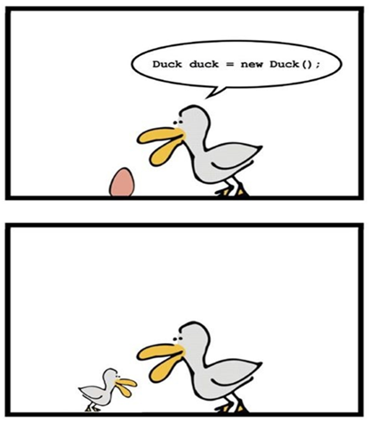
November 10, 2016
Target: I can write class and understand it Anatomy
Sync!! & Daily Review on Canvas
Copy G:\
  PairofDice, Boxcars
✓ Outline – while you work
Chapter 4 – Classes & Objects
  Class with private data of objects
  get and set methods
  pass by value vs reference
  Constructors, toString
  Class – public vs private
  constructors
  scope of data
  Work on Die & Client code
  Snake Eyes

Slide 5
November 10, 2016
Target: I can write class and understand it Anatomy
Sync!!
Daily Review on Canvas
  please save in your Repo
PairofDice, Boxcars
  class with another class as private data
✓ Outline – while you work
Chapter 4 – Classes & Objects
  Class with private data of objects
  get and set methods
  pass by value vs reference
  Constructors, toString
  Class – public vs private
  constructors
  scope of data

Slide 6
November 11, 2016
Target: I can write class and understand it Anatomy
Daily Review –
  copy code to snake eyes
  we will test in class
  answer 1 question
Chapter 4 – Classes & Objects
  Working with turtles
  classes and libraries
  creating methods in turtle
  documentation

Slide 7
November 14, 2016
Target: I can write class and understand it Anatomy
Return Labs
  Chapter 4 – Classes & Objects
  Working with turtles
  classes and libraries
  creating methods in turtle
    drawSquare ()
    drawSuare (int width)
  documentation
    simple turtle
  drawhex(int side)
  drawrec (int width, int hight()
  drawequilateralTriangle(int side)

Slide 8
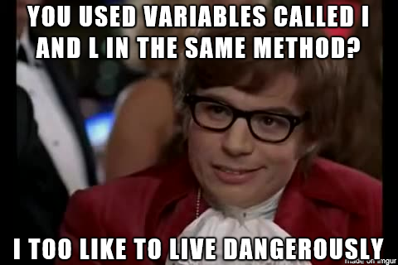
November 15, 2016 – Sync!
Target: I can write class and understand it Anatomy – end of class – comit & sync
Return Test
  Chapter 4 – Classes & Objects
Copy Rational & Rational Numbers G:\
  into Intro to Objects BlueJ project
Working with turtles
  creating methods in turtle
    drawSquare ()
    drawSuare (int width)
  documentation
    simple turtle
  randomwalk(int steps)
  drawrec (int width, int hight()
  drawequilateralTriangle(int side)

Slide 9
November 16, 2016 – Sync!
Target: I can write class and understand it Anatomy –end of class – commit & sync
Copy Rational & Rational Numbers G:\
  into Intro to Objects BlueJ project
  passing a method an object
Working with turtles – finish these methods
  creating methods in turtle
    drawSquare ()
    drawSuare (int width)
  documentation
    simple turtle
  randomwalk(int steps)
  drawrec (int width, int hight()
  drawequilateralTriangle(int side)

Slide 10
November 21, 2016 – Sync!
Target: I can write class and understand it Anatomy –end of class – commit & sync
Canvas assignments
  circuit lab
  friend lab
Finish labs
  Rational
  Turtle
  Account

Slide 11

November 22, 2016 – Sync!
Target: I can write class and understand it Anatomy –end of class – commit & sync
Canvas Daily review
Finish labs and turn in
  Rational
  Turtle – please have me ✓
  Account
per8 shutdown
computers

Slide 12
November 28, 2016 – Sync!
Target: I can write class and understand it Anatomy –end of class – commit & sync
Thursday – Exchange Day!!
Canvas Daily review
Finish labs late – please turn in!!
  Rational
  Turtle – please have me ✓
  Account
Circuit lab
Friend lab

Slide 13
November 29, 2016 – Sync!
Target: I can write class and understand it Anatomy –end of class – commit & sync
Thursday – Exchange Day!!
Short Daily review
Work day – Finish
  Circuit lab
  Friend lab
Finish labs late – please turn in!!
  Rational
  Turtle – please have me ✓
  Account

Slide 14
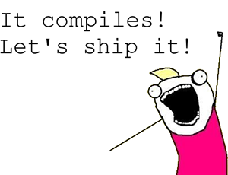
November 30, 2016 – Sync!
Target: I can write class and understand it Anatomy –end of class – commit & sync
Thursday – Exchange Day!!
Daily review
Work day – Finish
  Circuit lab
  Friend lab
Test Friday
  chapter 5 notes monday
Finish labs late – please turn in!!
  Rational
  Turtle – please have me ✓
  Account

Slide 15
November 12, 2015
Target: I can write class and understand it Anatomy
Test – make up last days
open Coin & Client code
Chapter 4 – Classes & Objects
  Constructors, toString
  Overloading Methods
  getters and setters
  Class – public vs private
  scope of data – done

Slide 16
November 13, 2015
Target: I can write class and understand it Anatomy
Test – make up last days ☹
open Coin & Client code
  functions in main class
Chapter 4 – Classes & Objects
  Constructors, toString
  Overloading Methods
  getters and setters
  Class – public vs private
  scope of data – done
Flip Race – post discussion
Canvas Review
  Intro QW 2015 open and complete

Slide 17
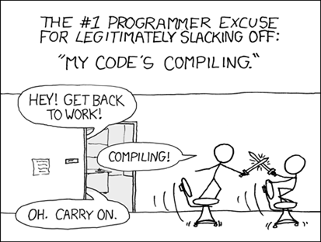
November 17, 2015
Target: I can use a class I have written
Flip Race – Canvas - on Canvas please download
Post – Canvas – after you finish Flip Race
Address Class – on Canvas please download
  this
  copy constructor
  equals method
Die – test with Snake Eyes
Pair of Dice class

Slide 18
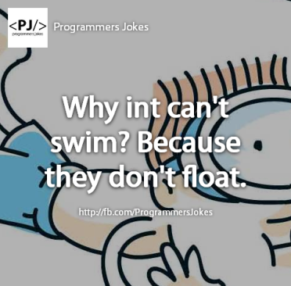
November 18, 2015
Target: I can use a class I have written
Post – Canvas – 12 minutes
  per 3 reply to per 7 or 8 (thoughtful, appropriate & respectful)
  per 7 and 8 reply to per 3 (thoughtful, appropriate & respectful)
Die – Student
  download again - die-student & snake eyes – slight changes
  test with Snake Eyes – student ✓ die class print code
Pair of Dice class
Box Cars test Pair of Dice
  teacher ✓ output print pair of dice code

Slide 19
November 23, 2015
Target: I can use a class I have written
TODAY:
  Die – Student test with Snake Eyes – student ✓ die code
Box Cars – test Pair of Dice - teacher ✓ output print pair of dice code
Open Address
Work on Circle
  draw(graphic Page)
  draw(graphic Page, x, y) – useful overload?
  equal(Circle obj)

Slide 20
November 24, 2015
Target: I can use a class I have written
TODAY:
  Die – Student test with Snake Eyes – student ✓, print die class
Box Cars – test Pair of Dice - teacher ✓, print pair of dice class
Rational – complete
  run Rational Numbers
Work on Circle
  draw(graphic Page)
  draw(graphic Page, x, y) – useful overload?
  equal(Circle obj)

Slide 21
November 30, 2015
Target: I can use a class I have written
Rational – complete
  run Rational Numbers
Work on Circle – print class teacher check output
  draw(graphic Page)
  draw(graphic Page, x, y) – useful overload?
  equal(Circle obj)
Student Lab
  lab on canvas
  Student class on canvas
EXCHANGE DAY – THURS DEC 3RD!! Fun Fun

Slide 22
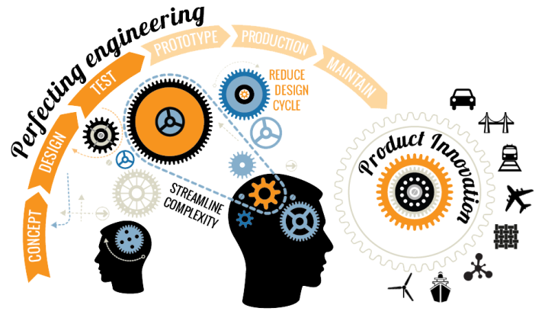
January 10, 2017
Target: I can write class using other object I have written
Update GitHub – download desktop
Rectangle
  constructors
  view two components
  animate/change
Other Shapes
  Oval, lines
Software Engineering Challenge
  another example
Show Applets Wed

Slide 23
January 11, 2017
Target: I can write class using other object I have written
Update GitHub – download desktop
Rectangle
  constructors
  view two components
  animate/change
Other Shapes
  Oval, lines
Multiple Random Circles – new Viewer
Show Applets Thursday

Slide 24
January 12, 2017
Target: I can write class using other object I have written
Update GitHub – download desktop
Multiple Random Circles – new Viewer
Show Applets
  down load files
  lineup and stickfigure

Slide 25
December 6, 2015
Target: I can write class using other object I have written
Teacher ✓ - print Circle Class
  Graphic of multiple circles ✓
Labs
  Rational – run Rational Numbers do not print
    Teacher ✓
  Student Class and Client code
    Sample output on back of lab sheet
Exchange Day Thursday
Software Engineering Challenge Wed

Slide 26
December 4, 2015
Target: I can write class using other object I have written
Quizzy Wizzy
Labs
  Rational – run Rational Numbers do not print
    Teacher ✓
  Student Class and Client code
    Print Client and 3 students (like sample output)
Software Engineering Challenge Wed
Test next week – Monday or Wed?

Slide 27
December 7, 2015
Target: I can write class using other object I have written
Test Monday/Tuesday
Labs
  Rational – run Rational Numbers do not print
    Teacher ✓
  Student Class and Client code
    Print Client and 3 students (like sample output)
Software Engineering Challenge
  Turn in Doc

Slide 28
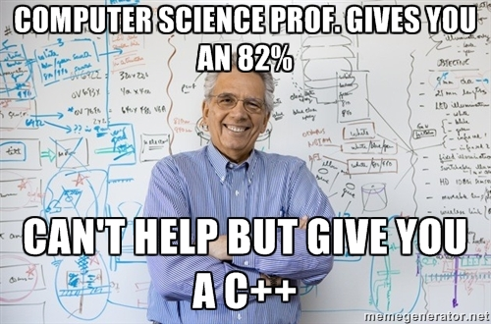
December 8, 2015
Target: I can write classes using other object I have written
Test Today – per 7,8
Labs – past due
  Rational – run Rational Numbers do not print
    Teacher ✓
  Student Class and Client code
    Print Client and 3 students (like sample output)
Software Engineering Challenge
  Turn in Doc!

Slide 29
December 9, 2015
Target: I can write classes using other classes/object I have written
Test make up 3 days
Labs – past due
  Rational – run Rational Numbers do not print
    Teacher ✓
  Student Class and Client code
    Print Client and 3 students (like sample output)
Software Engineering Challenge
  Turn in Doc!
  check on progress after 2 days
  seek help!!
Final Reviews - Canvas

Slide 30
December 10, 2015
Target: I can write classes using other classes/object I have written
Test make up 2 days
Labs – past due
  Rational – run Rational Numbers do not print
    Teacher ✓
  Student Class and Client code
    Print Client and 3 students (like sample output)
Software Engineering Challenge
  Turn in Doc!
  Screen shots
  seek help!!
Final Reviews – #1 Today!

Slide 31
November 19, 2015
Target: I can use a class I have written
Quiz – first 5 minutes
Post – Canvas – 12 minutes
  per 3 ✓reply
  per 7 and 8 ✓ reply
Die – Student
  test with Snake Eyes – student ✓ die class print code
Pair of Dice class – down load
Box Cars – download test Pair of Dice
  teacher ✓ output print pair of dice code

Slide 32
October 27, 2014
Target: I can write class using other object I have written
How was your weekend?
Pair of Dice – test with Box Cars
  Teacher ✓ - print PofD Class
Copy Address from G:\
  this reference
  Private Data – accessing, yea you can!
  equals method – what is equal?
Lab Makeup?

Slide 33
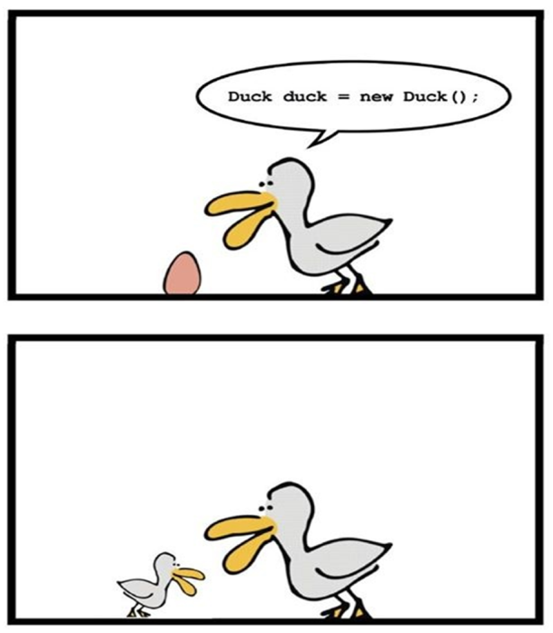
October 28, 2014
Target: I can write class using other object I have written
Pair of Dice – test with Box Cars
  Teacher ✓ - print PofD Class
  SOP(dice == dice2)
Review
  this reference
  Private Data – accessing, yea you can!
  equals method – what is equal?
Canvas – Circle Class & open book to p 162
Lab Makeup?

Slide 34
October 29, 2014
Target: I can write class using other object I have written
Die Quiz – This is a test this is only a test
  Teacher ✓ - print PofD Class
  SOP(dice == dice2)
Canvas – Circle Class & open book to p 162
Lab Makeup?

Slide 35
October 30, 2014
Target: I can write class using other object I have written
Die Quiz – period 5 finish
Teacher ✓ - print PofD Class
  SOP(dice .equals( dice2))
Canvas – Circle Class & open book to p 162
Lab Makeup?

Slide 36
October 31, 2014
Target: I can write class using other object I have written
Return Test
Teacher ✓ - print PofD Class
  SOP(dice .equals( dice2))
Canvas – Circle Class & open book to p 162
Lab Makeup?????????

Slide 37
November 3, 2014
Target: I can write class using other object I have written
Teacher ✓ - print Circle
  Graphic of multiple circles ✓
Labs – open book
  Start with Rational

Slide 38
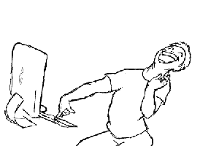
November 4, 2014
Target: I can write class using other object I have written
Teacher ✓ - print Circle
  Graphic of multiple circles ✓
  .draw Wednesday
Labs – open book
  Rational – turn in by Thursday
  Sample output on back of lab sheet

Slide 39
November 5, 2014
Target: I can write class using other object I have written
.draw Circle – thanks Kevin
Teacher ✓ - print Circle
  Graphic of multiple circles ✓
Labs – open book
  Rational – turn in by Thursday
  G:\Hand In\per#\namedfolder\Rational
  Sample output on back of lab sheet

Slide 40
November 7, 2014
Target: I can write class using other object I have written
Labs – open book
  Rational – turn in by Thursday
  G:\Hand In\per#\namedfolder\Rational
  Sample output on back of lab sheet
  Working on other labs
Review Quiz on desk – please write out 3 questions in first 5 minutes of class

Slide 41
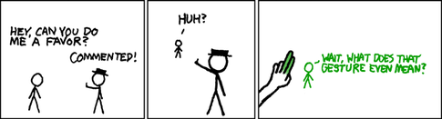
November 10, 2014
Target: I can write class using other object I have written
Rational – turned last week
  G:\Hand In\per#\namedfolder\Rational
  Sample output on back of lab sheet
Work Day
Review Quiz on desk – please complete

Slide 42
November 11, 2014
Target: I can write class using other object I have written
Rational – turned last week
  G:\Hand In\per#\namedfolder\Rational
  Sample output on back of lab sheet
Work Day – Finish Student & Account
Start on Building & Skyline
Two bytes meet. The first byte asks, “Are you ill?”
The second byte replies, “No, just feeling a bit off.”

Slide 43
November 12, 2014
Target: I can write class using other object I have written
Rational – turned last week
  G:\Hand In\per#\namedfolder\Rational
  Sample output on back of lab sheet
Work Day – Finish Student & Account
Start on Building & Skyline
Two bytes meet. The first byte asks, “Are you ill?”
The second byte replies, “No, just feeling a bit off.”

Slide 44
November 13, 2014
Target: I can write class using other object I have written
Hand in– Student & Account
Building & Skyline
  Book – look at Stick Figure & Line up
Short Review on Desk – please complete in first 10 minutes

Slide 45
November 14, 2014
Target: I can write class using other object I have written
Hand in– Student & Account
Building & Skyline – working on
  Book – look at Stick Figure & Line up
Answer AP Style Multiple Choice p234-5
  4.1 – 4 – OPEN CANVAS and click Quiz tab
Test next week Tuesday/Wednesday ?

Slide 46
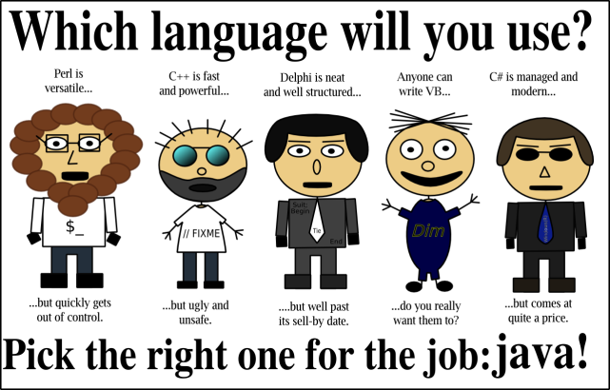
November 17, 2014
Target: I can write class using other object I have written
Short Review – Test Wed
Building & Skyline – work on
  Lookat Stick Figure & Line up

Slide 47
November 18, 2014
Target: I can write class using other object I have written
Test Wednesday
Building & Skyline – work on
  Folder: G:\Handin\firstlastSkyline
Outline Ch 5 due Thursday
  Will be on Canvas

Slide 48
November 19, 2014
Target: I can take a test
Test – take scantron
Building & Skyline – due
  Folder: G:\Handin\firstlastSkyline
Outline Ch 5 due Thursday
  Will be on Canvas

Slide 49
September 4, 2014
Target: I can if statements to control flow of my program
 Post to Canvas ?
Test – make up 3 days
Chapter 3 – if statements
  Intro - notes
  Objects == ?
  && == nested
  Short circuit evaluation
  Switch
  doubles and if’s
  De Morgan's Law & Truth tables

Slide 50
September 4, 2014
Target: I can if statements to control flow of my program
 Post to Canvas ?
Test – make up 3 days
Chapter 3 – if statements
  Intro - notes
  Objects == ?
  && == nested
  Short circuit evaluation
  Switch
  doubles and if’s
  De Morgan's Law & Truth tables

Slide 51
September 4, 2014
Target: I can if statements to control flow of my program
Return Labs –
Type program 1 in notes
Test – make up 3 days
Chapter 3 – if statements
  Short circuit evaluation
  Switch
  doubles and if’s
  De Morgan's Law & Truth tables
    Take handout
  Intro labs

Slide 52
September 8, 2014
Target: I can if statements to control flow of my program
Chapter 3 – if statements
  Intro labs – listed on canvas :2,6 your choice of 4 or 5
  Quizzy Wizzy

Slide 53
September 10, 2014
Target: I can if statements to control flow of my program
Chapter 3 – if statements
  Intro labs – listed on canvas :2,6 your choice of 4 or 5
  Check program 2 – teacher output
  Program 6 -Print code and 2 outputs
  Answer a few questions

Slide 54
September 15, 2014
Target: I can if statements to control flow of my program
TurtleGraphics – g:\handout\apcs
BreezySwing – g:\handout\apcs
Draw square handout on back
Chapter 3 –Labs
  Write down how to turn in
Test at the end of the week
Any intro labs left?
  Check program 2 – teacher output
  Program 6 print code and 2 outputs

Slide 55
September 16, 2014
Target: I can if statements to control flow of my program
Lab Day – Work and Finish labs
Chapter 3 –Labs
  Notify me if you have a lab to check
Test at the end of the week
Any intro labs left?
  Check program 2 – teacher output
  Program 6 print code and 2 outputs

Slide 56
September 18, 2014
Target: I can if statements to control flow of my program
Chapter 3 outline due Monday – Collaborations will be posted (no late work will be accepted)
Lab Day – Labs are due
Chapter 3 –Labs
  Notify me if you have a lab to check
Test Friday
Posting

Slide 57
September 19, 2014
Target: I can if statements to control flow of my program while I take a test

Slide 58
September 22, 2014
Target: I can for and while statements to control flow of my program
Take out Chapter 3 outline – Collaborations are to be posted
Friday Test & Labs were due – 3 days to make up test
Chapter 3 –Intor loops – while and for syntax
Basic programs – average, guess the number printing triangle of *

Slide 59
September 23, 2014
Target: I can understand an iterator and use file io
Missing?? Chapter 3 outline – come to desk and have me check it off
Friday Test & Labs were due – 2 days to make up test
Chapter 3 –Into loops – while and for syntax
Basic programs – average, FizzBuzz
File IO and Iterators – what is an iterator??

Slide 60
September 24, 2014
Target: I can understand an iterator and use file io
Quizzy Wizzy – start at the bell
Friday Test & Labs were due – 1 day to make up test
Chapter 3 –For each loop
File IO and Iterators – what is an iterator??
  Review
Practice programs

Slide 61
September 25, 2014
Target: I can use loops structure to solve programming problmes
AP loop questions – first 3 done can have ½ donut
Return Labs
Practice loop labs – I added a few requirements – on Canvas
Q: How do you tell an introverted computer scientist from an extroverted computer scientist?
A: An extroverted computer scientist looks at your shoes when he talks to you.

Slide 62
September 26, 2014
Target: I can use loops structure to solve programming problmes
Sub
Finish practice Labs
Practice loop labs – I added a few requirements – on Canvas
Q: How do you tell an introverted computer scientist from an extroverted computer scientist?
A: An extroverted computer scientist looks at your shoes when he talks to you.

Slide 63
September 27, 2014
Target: I can use loops structure to solve programming problmes
Review sheet – take one
Return Test
Practice Labs – should be finished
  Partner should check output and code
Loop Programs - on Canvas
If you put a million monkeys at a million keyboards, one of them will eventually write a Java program.
The rest of them will write Perl programs.

Slide 64

September 30, 2014
Target: I can use loops structure to solve programming problmes
Loop Labs– take one
Practice Labs – should be finished
  Partner should check output and code
Q: What do you do if your dog chews a dictionary?
A: Take the words out of his mouth!

Slide 65
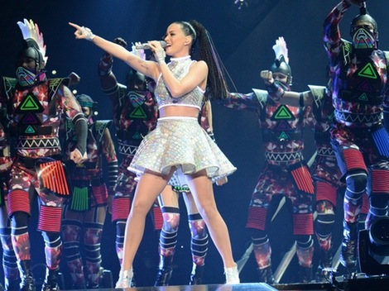
October 1, 2014
Target: I can use loops structure to solve programming problmes
Graphic lab & file io
Loop Labs– write this down
Work Day

Slide 66
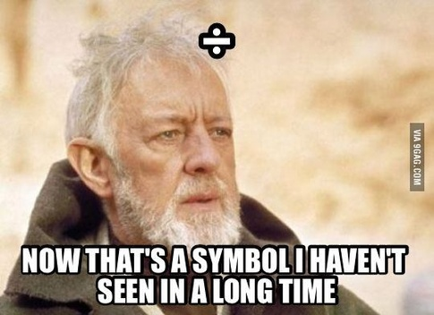
October 2, 2014
Target: I can use loops structure to solve programming problmes
Graphic lab – open Canvas
Work Day

Slide 67
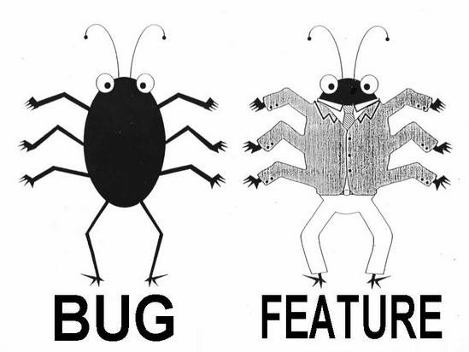
October 3, 2014
Target: I can use loops structure to solve programming problmes
File IO lab– open Canvas
Work Day
Get programs checked!
BRING YOUR BOOKS!!
  Returning Norths

Slide 68
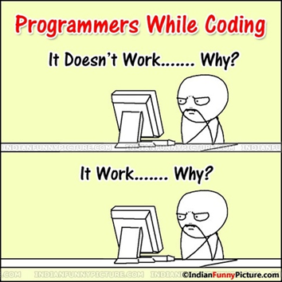
October 6, 2014
Target: I can use loops structure to solve programming problmes
Work Day
Get programs checked!
BRING YOUR BOOKS!!
  Returning North’s

Slide 69
October 7, 2014
Target: I can use loops structure to solve programming problmes
Finish up Labs and turn in.
Get programs checked! Any one?
Short Quiz on Loops Wed
BRING YOUR BOOKS!!
  Returning North’s
Little Quizzy Wizzy

Slide 70

October 8, 2014
Target: I can use loops structure to solve programming problmes
Labs due.
Get programs checked!
Short Quiz on Loops – Relax!

Slide 71
October 13, 2014
Target: I can understand the media files picture, pixel and color
Labs due last week.
Review - Short Quiz on Loops
  Turn in if parents have copy at conferences
Picture Lab – get it to work
  Read thru p 6 and answer question (Word Doc)
  Understand color, picture, explorer & pixel

Slide 72
October 14, 2014
Target: I can understand the media files picture, pixel and color
Picture Lab – get it to work
10 minutes to turn in Word doc with answers
  Read thru p 6 and answer question (Word Doc)
  Understand color, picture, explorer & pixel
  Array notetation
  For loop – index vs for each loop (objects)

Slide 73
October 15, 2014
Target: I can understand the media files picture, pixel and color
Picture Lab – clear & reduce RGB
  Write loops to access elements in array
  Change color values using Pixel methods
Loop questions – please answer
Test Ch 3 Loop Friday
Ch 4 outline && post due by Monday
  Posts – lets talk about this

Slide 74
October 17, 2014
Target: I can understand the media files picture, pixel and color
Picture Lab – clear & reduce RGB
  Write loops to access elements in array
  Change color values using Pixel methods
  Negative and Grayscale
Quizzy Wizzy – please pick up and complete
Test Ch 3 Loop Monday
Ch 4 outline && post due by Monday
Q. Why was the statement scared while the comment was not?
A. Statements are executed.

